Slide 1



LAN/WLAN World
LANs provide connectivity for interconnecting computing resources at the local levels of an organization
Wired LANs
    Limitations because of physical, hard-wired infrastructure
Wireless LANs provide
    Flexibility
    Portability
    Mobility
    Ease of Installation

Slide 2


Wireless LAN Applications
Medical Professionals
Education
Temporary Situations
Airlines
Security Staff
Emergency Centers

Slide 3
IEEE 802.11 Wireless LAN Standard
In response to lacking standards, IEEE developed the first internationally recognized wireless LAN standard – IEEE 802.11
IEEE published 802.11 in 1997, after seven years of work
Most prominent specification for WLANs
Scope of IEEE 802.11 is limited to Physical and Data Link Layers.

Slide 4
Benefits of 802.11 Standard
Appliance Interoperability
Fast Product Development
Stable Future Migration
Price Reductions
The 802.11 standard takes into account the following significant differences between wireless and wired LANs:
    Power Management
    Security
    Bandwidth

Slide 5
IEEE 802 LAN Standards Family
IEEE 802.2
Logical Link Control (LLC)
OSI Layer 2
(Data Link)
IEEE 802.3
Carrier
Sense
IEEE 802.4
Token
Bus
IEEE 802.5
Token
Ring
IEEE 802.11
Wireless
Mac
OSI Layer 1
(Physical)
PHY

Slide 6
IEEE 802.11 Terminology
Access point (AP): A station that provides access to the DS.
Basic service set (BSS): A set of stations controlled by a single AP.
Distribution system (DS): A system used to interconnect a set of BSSs to create an ESS.
  DS is implementation-independent. It can be a wired 802.3 Ethernet LAN, 802.4 token bus, 802.5 token ring or another 802.11 medium.
Extended service set (ESS):Two or more BSS interconnected by DS
Portal: Logical entity where 802.11 network integrates with a non 802.11 network.

Slide 7
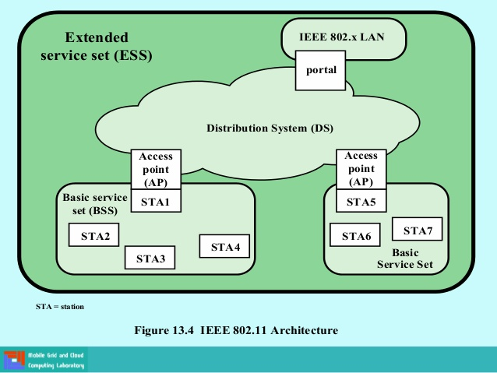

Slide 8
IEEE 802.11 Services: Distribution of Messages
Distribution service (DS)
  Used to exchange MAC frames from station in one BSS to station in another BSS
Integration service
  Transfer of data between station on IEEE 802.11 LAN and station on integrated IEEE 802.x LAN

Slide 9
IEEE 802.11 Medium Access Control
MAC layer covers three functional areas:
  Reliable data delivery
  Access control
  Security

Slide 10
Reliable Data Delivery
Loss of frames due to noise, interference, and propagation effects
Frame exchange protocol
  Source station transmits data
  Destination responds with acknowledgment (ACK)
  If source doesn’t receive ACK, it retransmits frame
Four frame exchange for enhanced reliability
  Source issues request to send (RTS)
  Destination responds with clear to send (CTS)
  Source transmits data
  Destination responds with ACK

Slide 11
Access Control
Distributed Coordination Function (DCF)
  Distributed access protocol
  Contention-Based
  Makes use of CSMA/CA rather than CSMA/CD
  Suited for ad hoc network and ordinary asynchronous traffic
Point Coordination Function (PCF)
  Alternative access method on top of DCF
  Centralized access protocol
  Contention-Free
  Works like polling
  Suited for time bound services like voice or multimedia

Slide 12
Interframe Space (IFS)
Defined length of time for control
SIFS - Short Inter Frame Spacing
  Used for immediate response actions e.g ACK, CTS
PIFS - Point Inter Frame Spacing
  Used by centralized controller in PCF scheme
DIFS - Distributed Inter Frame Spacing
  Used for all ordinary asynchronous traffic
  DIFS (MAX) > PIFS > SIFS (MIN)

Slide 13

IEEE 802.11 Security
Authentication provided by open system or shared key authentication (Authentication is used instead of wired media physical connection)
Privacy provided by WEP (Privacy is used to provide the confidential aspects of closed wired media)
An Integrity check is performed using a 32-bit CRC

Slide 14
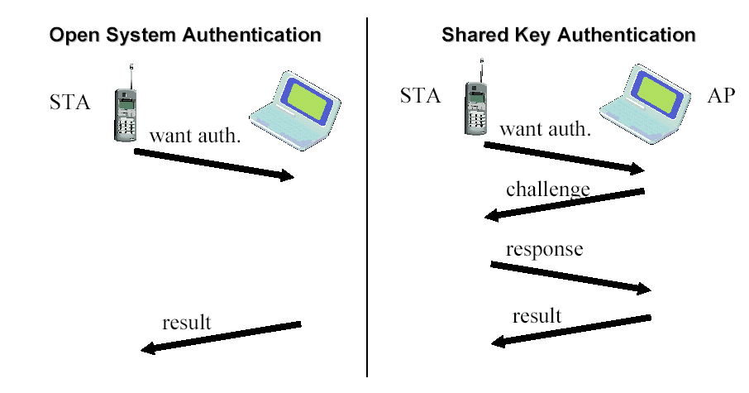
Authentication

Slide 15
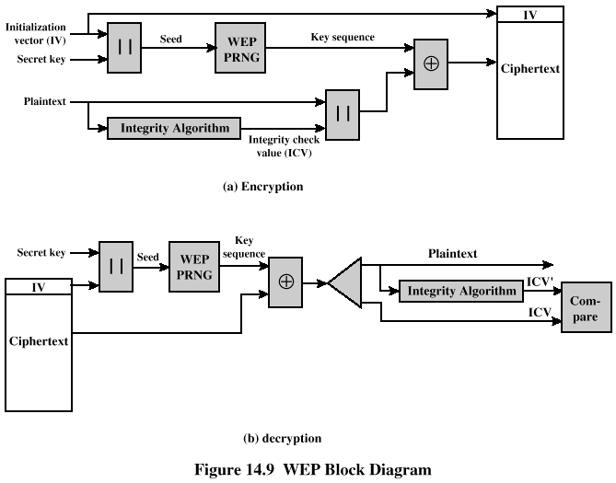
WEP Encryption/Decryption

Slide 16
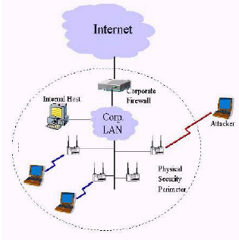
Is WLAN Secure ?
The Parking Lot attack
Man in the middle attack
Freely available tools like Air Snort, WEP crack to snoop into a WLAN

Slide 17
IEEE 802.11a and IEEE 802.11b
IEEE 802.11a
  Makes use of 5-GHz band
  Provides rates of 6, 9 , 12, 18, 24, 36, 48, 54 Mbps
  Uses orthogonal frequency division multiplexing (OFDM)
IEEE 802.11b
  802.11b operates in 2.4 GHz band
  Provides data rates of 5.5 and 11 Mbps
  Complementary code keying (CCK) modulation scheme
  For more information: http://home.no.net/coverage/rapport/80211.htm

Slide 18
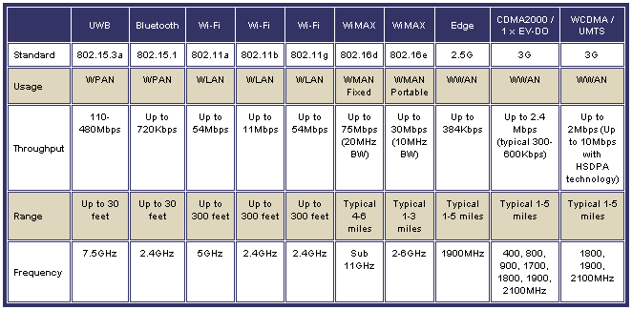
Types of Wireless Network

Slide 19
THANKU

